Slide 1
Envelope analysis
October 2024
Andrea Corrado

Slide 2
Outline
Aim of envelope analysis
Envelope analysis pipeline
Envelope derivative
Derivative thresholding and merging
Time thresholds definition
Results
Proposed features
Improving KB classifier
Conclusions
Appendix: not discriminative features

Slide 3
Outline
Aim of envelope analysis
Envelope analysis pipeline
Envelope derivative
Derivative thresholding and merging
Time thresholds definition
Results
Proposed features
Improving KB classifier
Conclusions
Appendix: not discriminative features

Slide 4
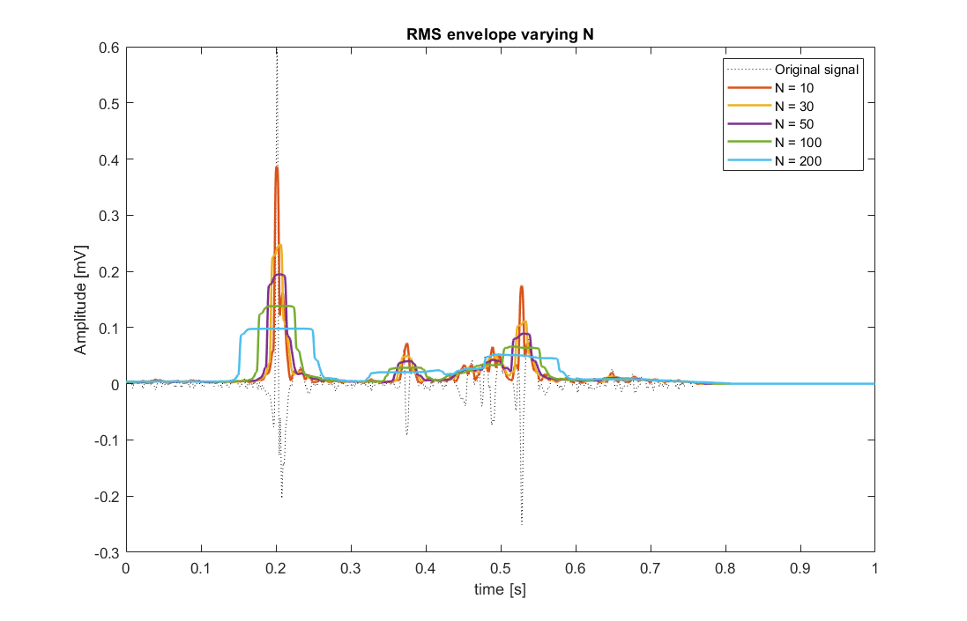
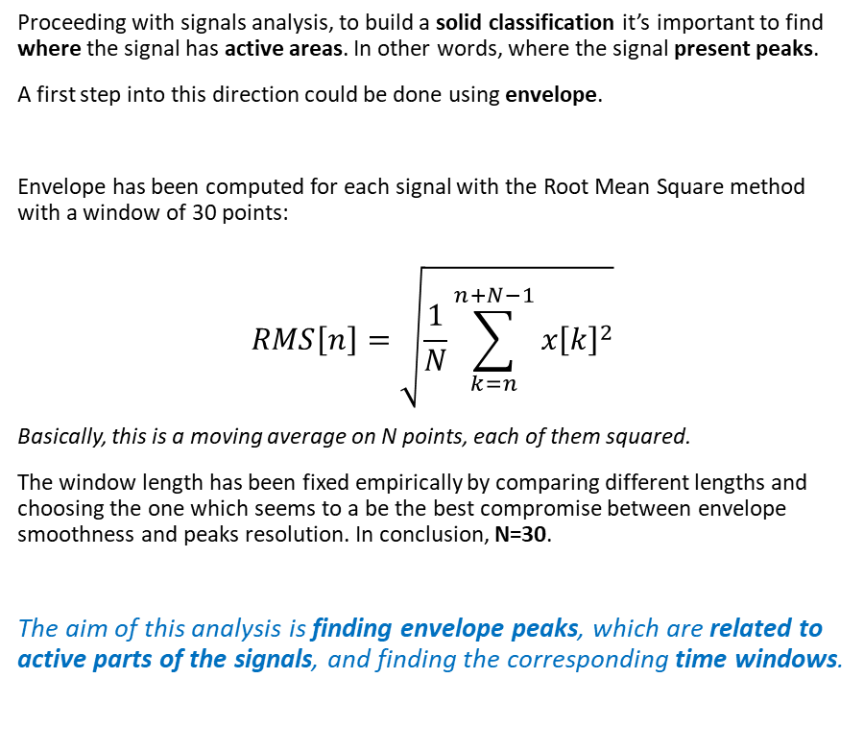
Aim of envelope analysis
Proceeding with signals analysis, to build a solid classification it’s important to find where the signal has active areas. In other words, where the signal present peaks.
A first step into this direction could be done using envelope.
Envelope has been computed for each signal with the Root Mean Square method with a window of 30 points:
$$RMS\left[n\right]=\sqrt{\frac{1}{N}\sum_{k=n}^{n+N−1}{x{\left[k\right]}^{2}}}$$
Basically, this is a moving average on N points, each of them squared.
The window length has been fixed empirically by comparing different lengths and choosing the one which seems to a be the best compromise between envelope smoothness and peaks resolution. In conclusion, N=30.
The aim of this analysis is finding envelope peaks, which are related to active parts of the signals, and finding the corresponding time windows.

Slide 5
Outline
Aim of envelope analysis
Envelope analysis pipeline
Envelope derivative
Derivative thresholding and merging
Time thresholds definition
Results
Proposed features
Improving KB classifier
Conclusions
Appendix: not discriminative features

Slide 6
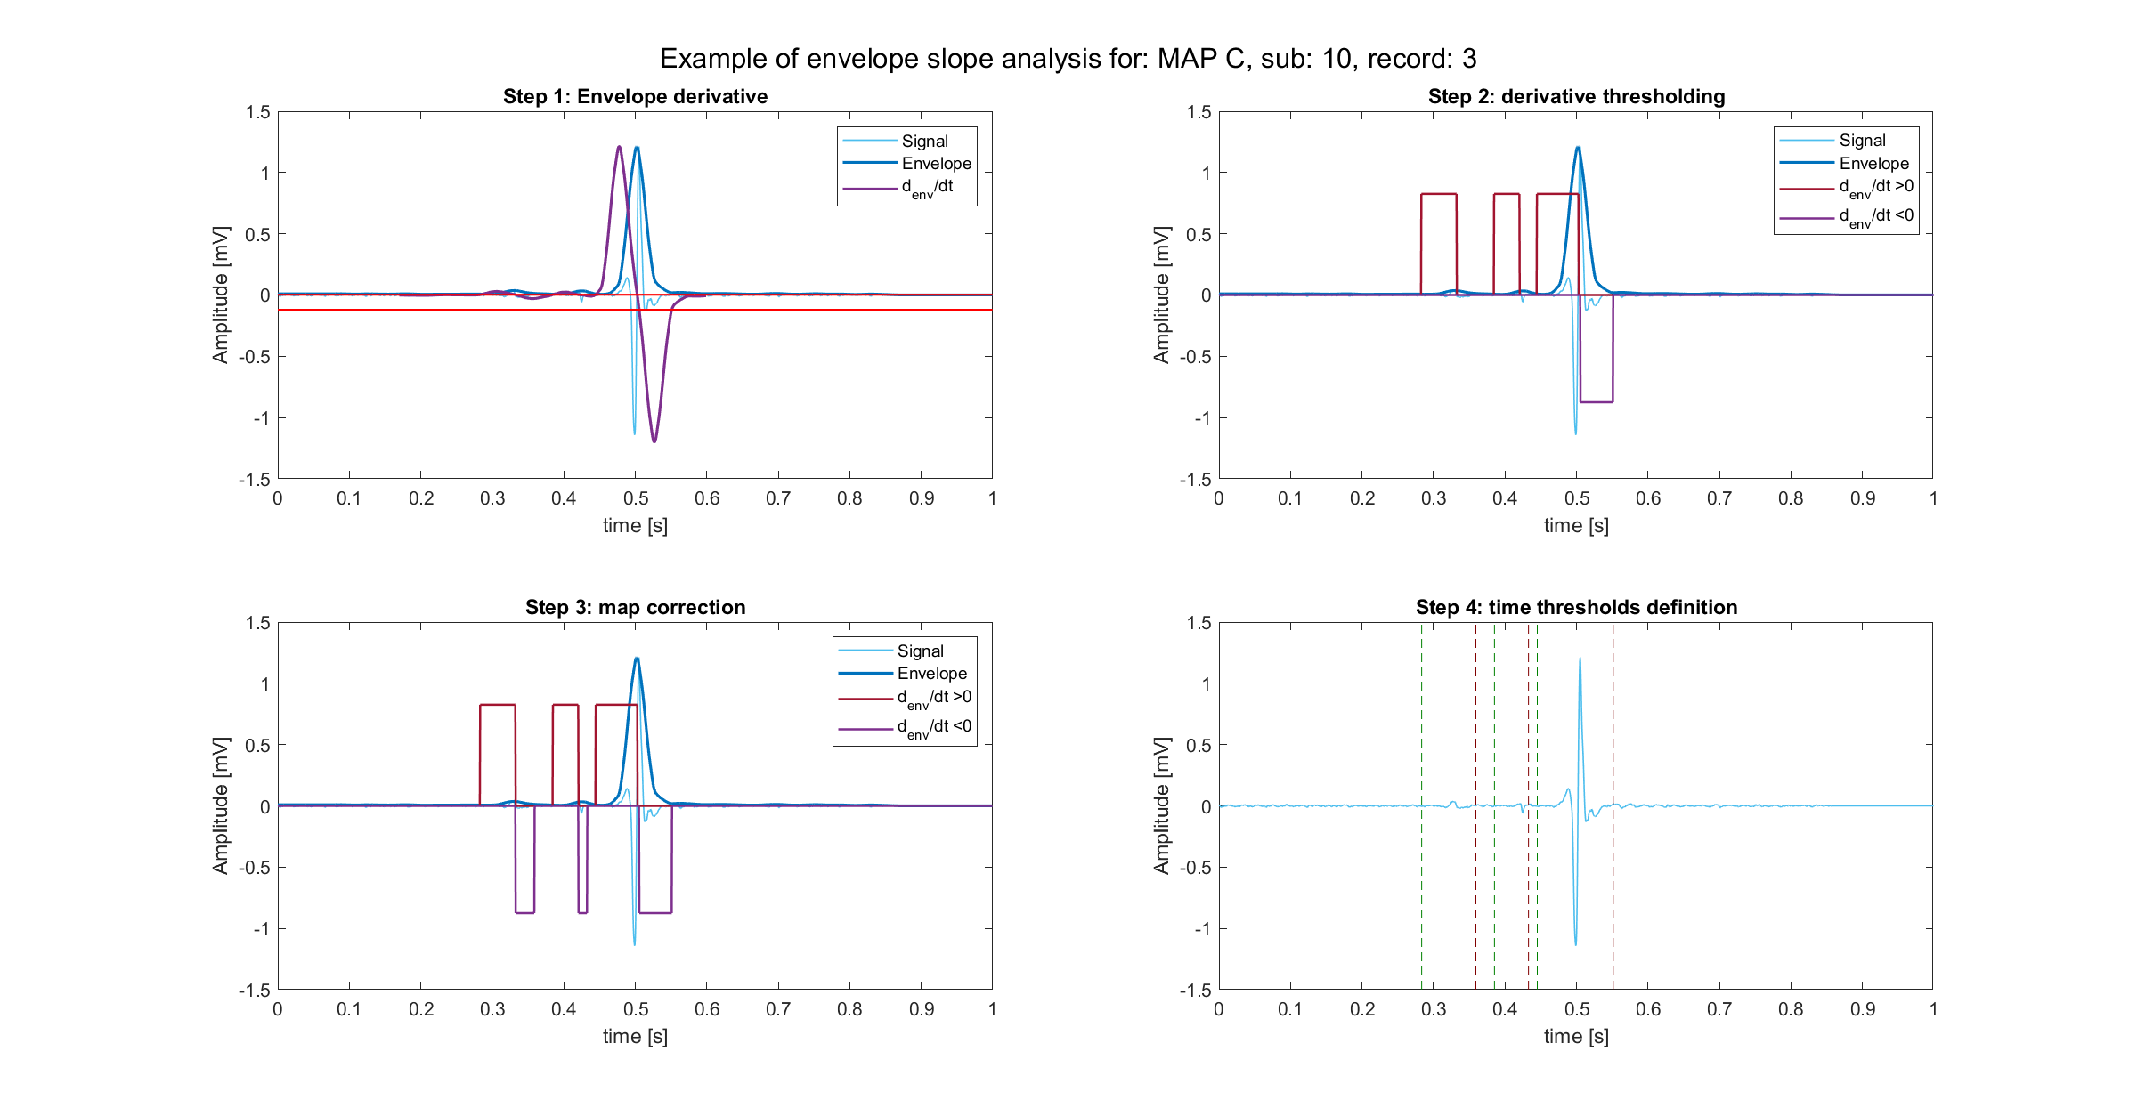
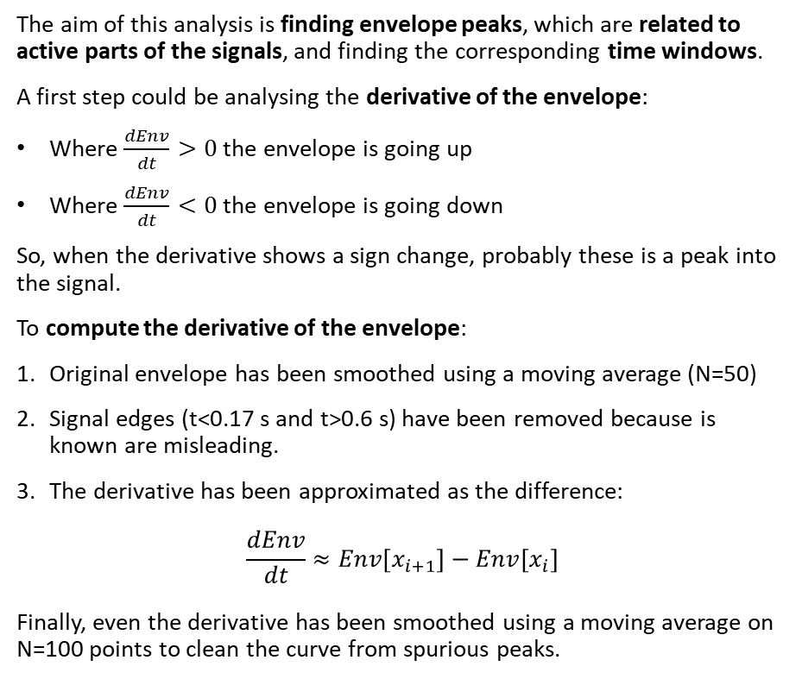
Envelope analysis: derivative computation
The aim of this analysis is finding envelope peaks, which are related to active parts of the signals, and finding the corresponding time windows.
A first step could be analysing the derivative of the envelope:
Where $\frac{dEnv}{dt}>0$ the envelope is going up
Where $\frac{dEnv}{dt}<0$ the envelope is going down
So, when the derivative shows a sign change, probably these is a peak into the signal.
To compute the derivative of the envelope:
Original envelope has been smoothed using a moving average (N=50)
Signal edges (t<0.17 s and t>0.6 s) have been removed because is known are misleading.
The derivative has been approximated as the difference:
$$\frac{dEnv}{dt}≈Env\left[x_{i+1}\right]−Env[x_{i}]$$
Finally, even the derivative has been smoothed using a moving average on N=100 points to clean the curve from spurious peaks.

Slide 7
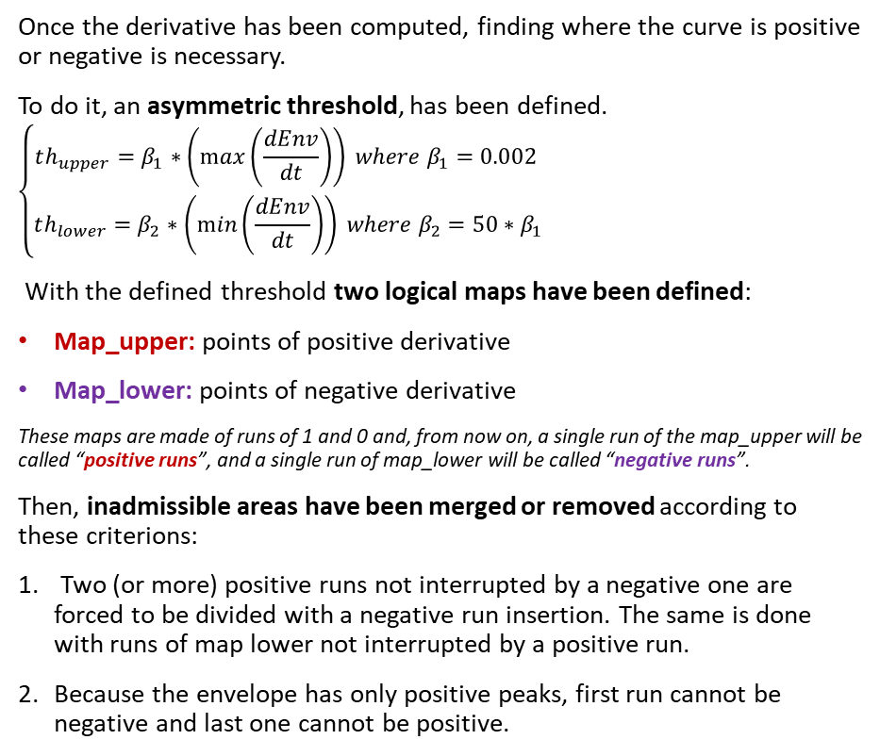
Envelope analysis: derivative thresholding
Once the derivative has been computed, finding where the curve is positive or negative is necessary.
To do it, an asymmetric threshold, has been defined.
$$\left\{\begin{aligned}th_{upper}=β_{1}∗\left(\max\left(\frac{dEnv}{dt}\right)\right) where β_{1}=0.002 \\ th_{lower}=β_{2}∗\left(\min\left(\frac{dEnv}{dt}\right)\right) where β_{2}=50∗β_{1}\end{aligned}\right.$$
With the defined threshold two logical maps have been defined:
Map_upper: points of positive derivative
Map_lower: points of negative derivative
These maps are made of runs of 1 and 0 and, from now on, a single run of the map_upper will be called “positive runs”, and a single run of map_lower will be called “negative runs”.
Then, inadmissible areas have been merged or removed according to these criterions:
Two (or more) positive runs not interrupted by a negative one are forced to be divided with a negative run insertion. The same is done with runs of map lower not interrupted by a positive run.
Because the envelope has only positive peaks, first run cannot be negative and last one cannot be positive.
Higher sensibility to ascends
Lower sensibility to descends

Slide 8
Envelope analysis: time threshold definition
Finally, time threshold can be computed easily:
First point of each positive run begins an active portion
Last point of each negative run ends the active portion

Slide 9
Outline
Aim of envelope analysis
Envelope analysis pipeline
Envelope derivative
Derivative thresholding and merging
Time thresholds definition
Results
Proposed features
Improving KB classifier
Conclusions
Appendix: not discriminative features

Slide 10
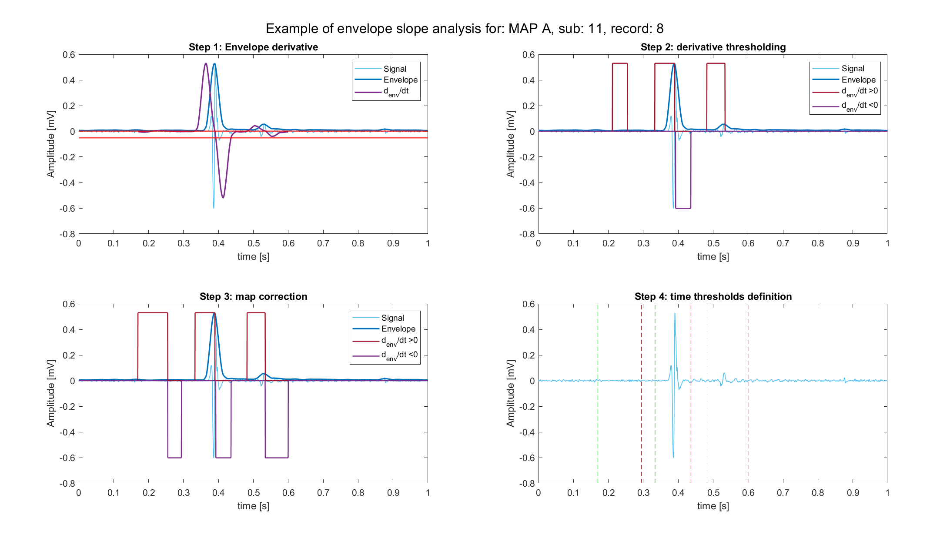
MAP A example

Slide 11
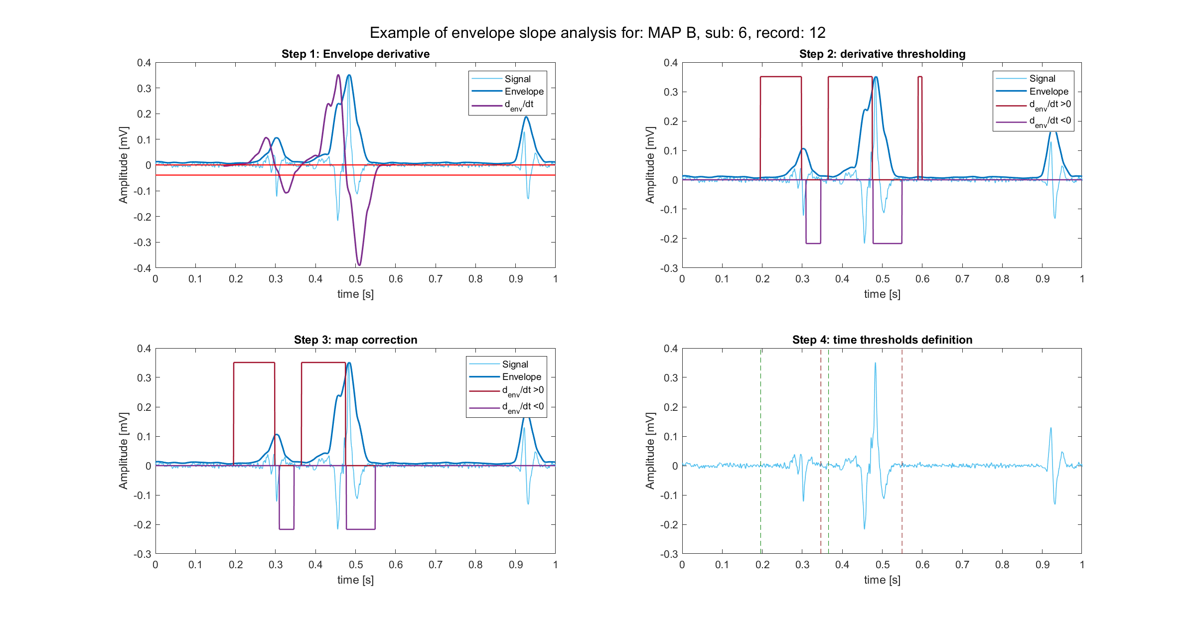
MAP B example

Slide 12
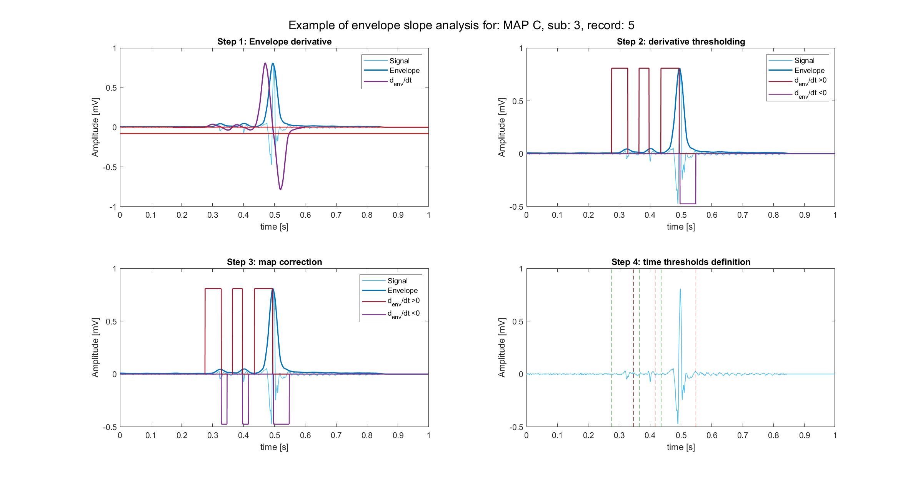
MAP C example

Slide 13
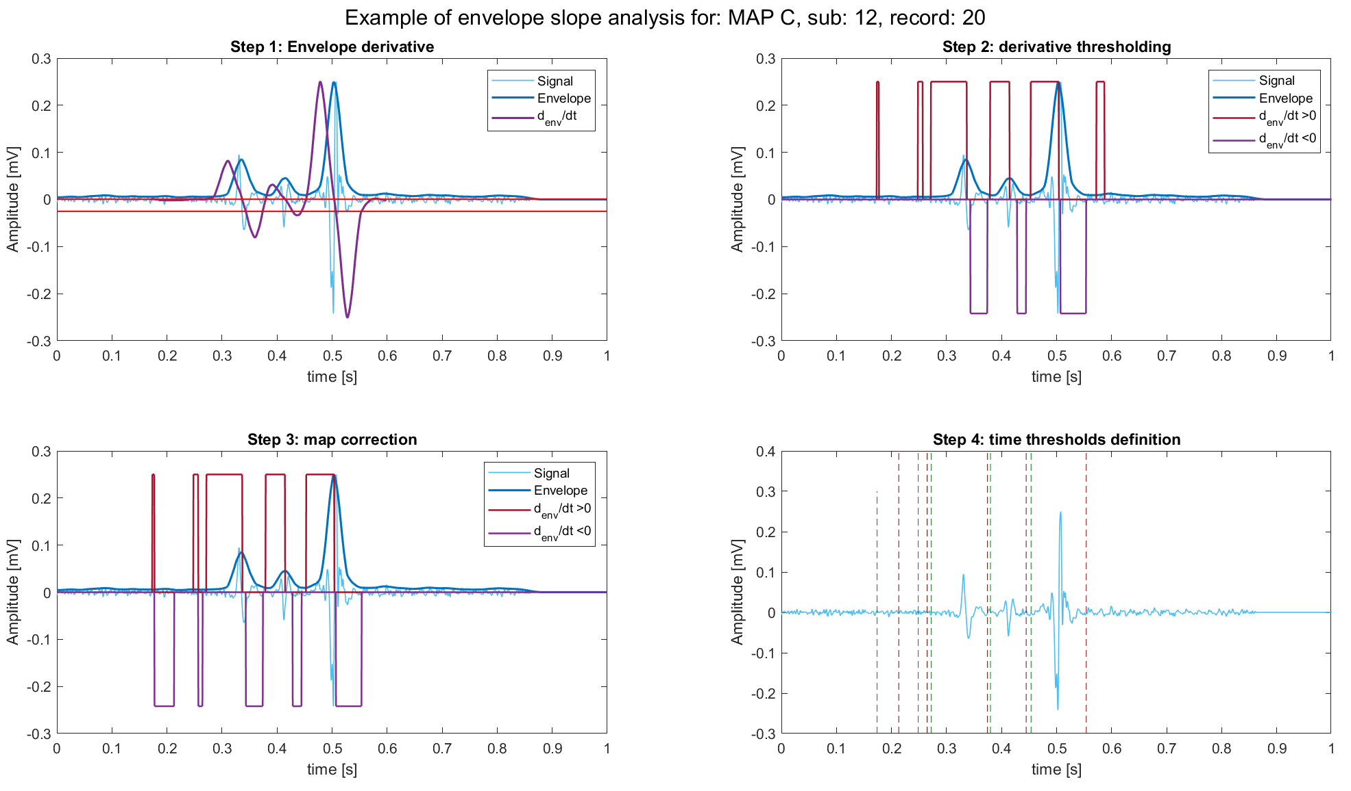
The over-detecting problem
This pipeline has, by building, a peculiarity: peaks are found in superabundance. In fact:
high sensibility of the upper threshold, even noise could be detected as peak.
the logic used into map cleaning favors the detection of new peaks.
In other words, this pipeline works with the logic “the higher, the better”.
This problem could be solved into peak detection phase, but it has been chosen to leave to work to feature extraction phase.
Peaks finally detected are the three main peaks (in descending order) of the signal
With such definition, a noise peak could be easily discharged, at least if the signal is not too noisy (but even a less sensible pipeline would be deceived in this case).

Slide 14
Outline
Aim of envelope analysis
Envelope analysis pipeline
Envelope derivative
Derivative thresholding and merging
Time thresholds definition
Results
Proposed features
Improving KB classifier
Conclusions
Appendix: not discriminative features

Slide 15
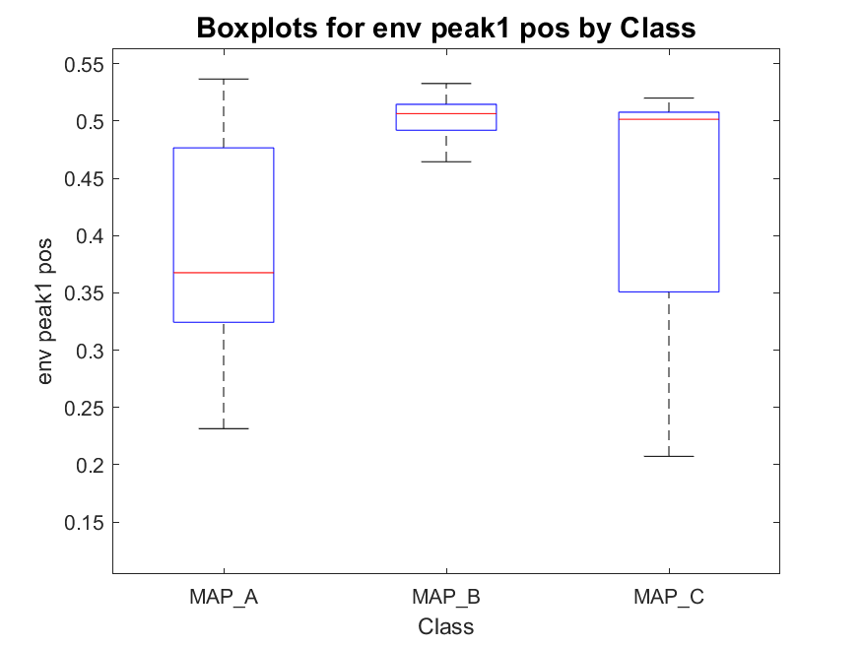
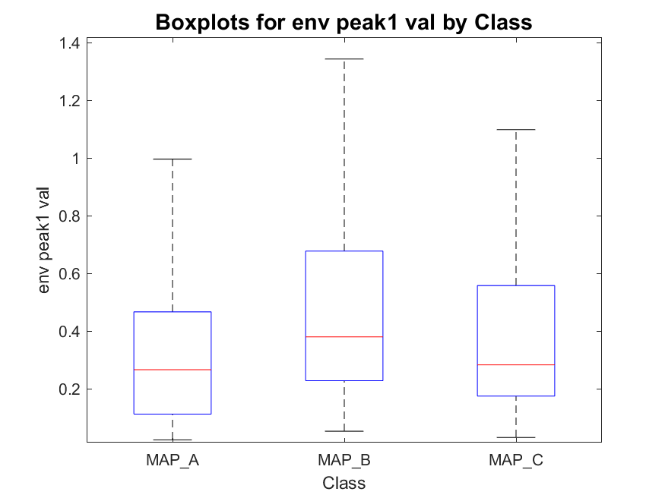
Envelope peak 1 (highest) position and value
MAP_A has:
- 22 signals with one peak
- 254 signals with two peaks
- 387 signals with three peaks
total : 663
MAP_B has:
- 0 signals with one peak
- 41 signals with two peaks
- 53 signals with three peaks
total : 94
MAP_C has:
- 2 signals with one peak
- 12 signals with two peaks
- 76 signals with three peaks
total : 90

Slide 16
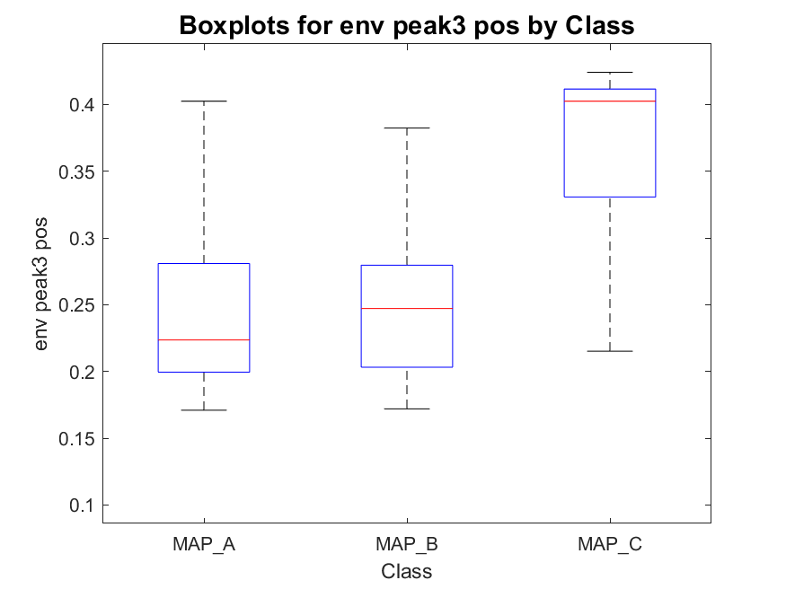
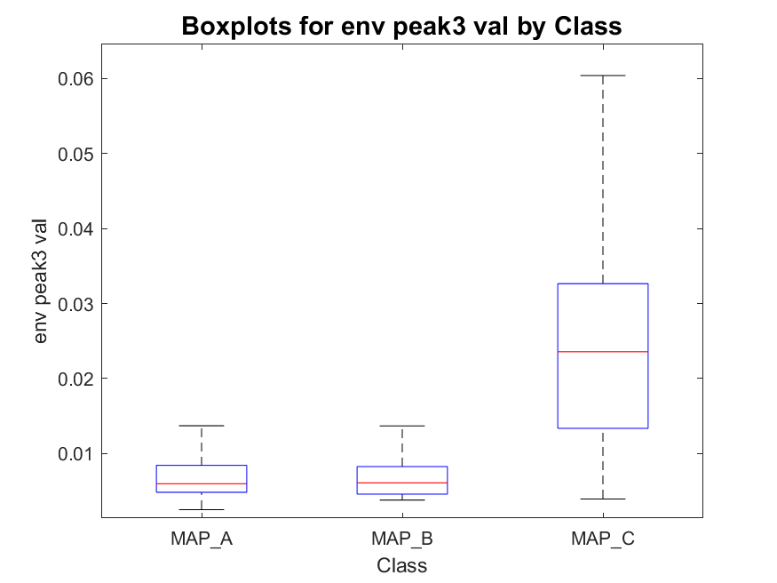
Envelope peak 3 (third highest) position and value
MAP_A has:
- 22 signals with one peak
- 254 signals with two peaks
- 387 signals with three peaks
total : 663
MAP_B has:
- 0 signals with one peak
- 41 signals with two peaks
- 53 signals with three peaks
total : 94
MAP_C has:
- 2 signals with one peak
- 12 signals with two peaks
- 76 signals with three peaks
total : 90

Slide 17
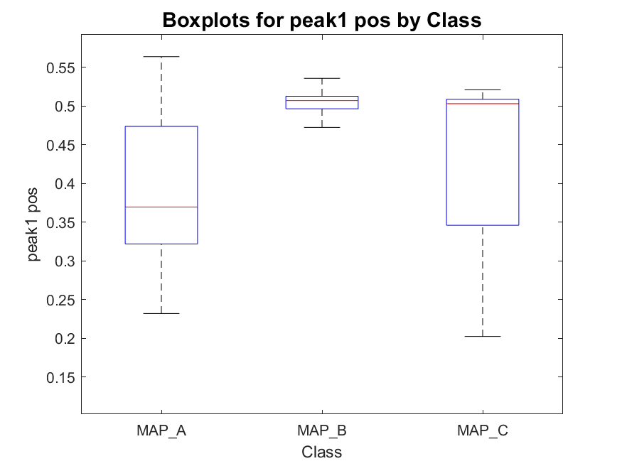
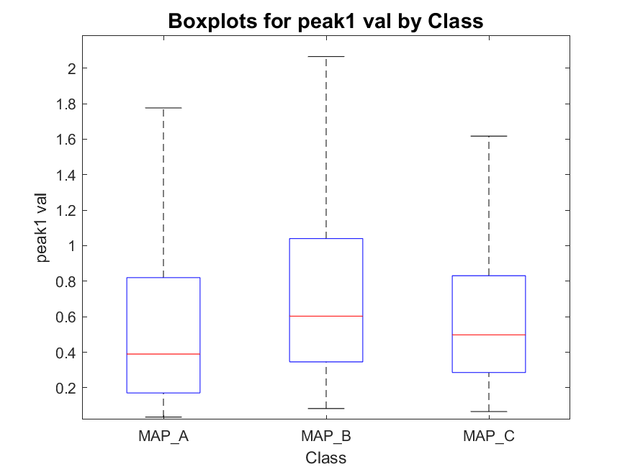
Signals absolute peak 1 (highest) position and value
MAP_A has:
- 22 signals with one peak
- 254 signals with two peaks
- 387 signals with three peaks
total : 663
MAP_B has:
- 0 signals with one peak
- 41 signals with two peaks
- 53 signals with three peaks
total : 94
MAP_C has:
- 2 signals with one peak
- 12 signals with two peaks
- 76 signals with three peaks
total : 90

Slide 18
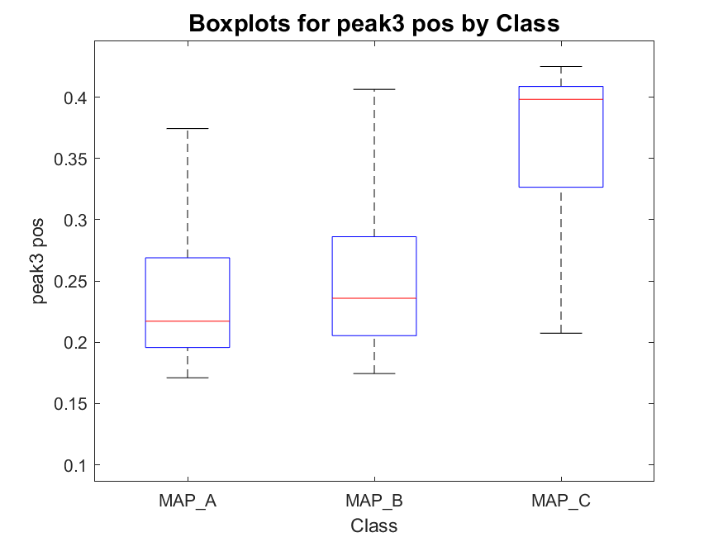
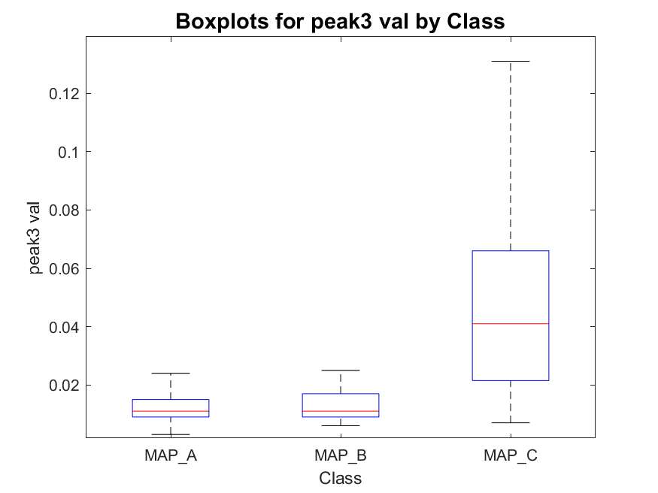
Signal absolute peak 3 (third highest) position and value
MAP_A has:
- 22 signals with one peak
- 254 signals with two peaks
- 387 signals with three peaks
total : 663
MAP_B has:
- 0 signals with one peak
- 41 signals with two peaks
- 53 signals with three peaks
total : 94
MAP_C has:
- 2 signals with one peak
- 12 signals with two peaks
- 76 signals with three peaks
total : 90

Slide 19
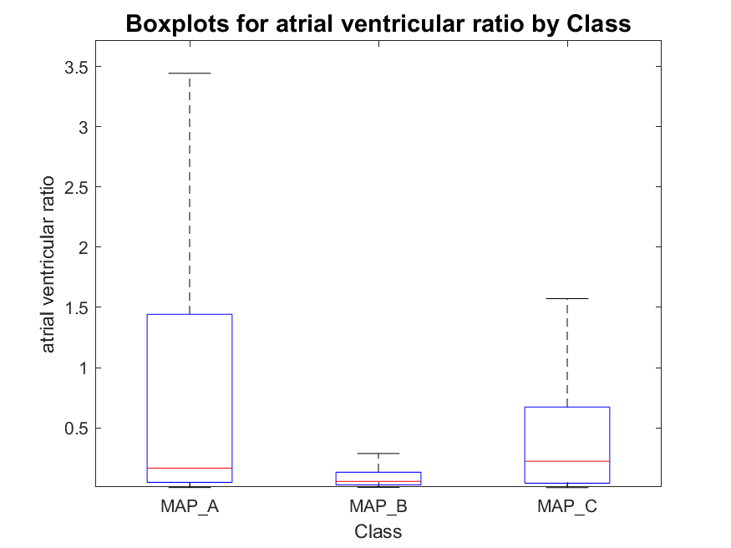
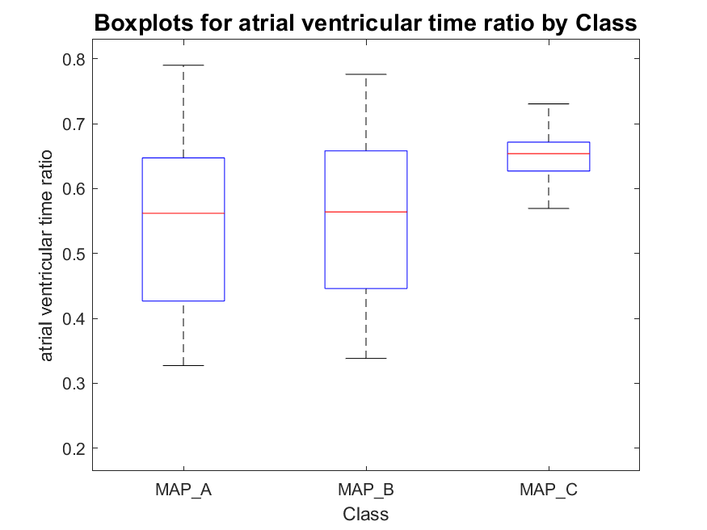
Atrial-to-ventricular envelope peaks ratio
MAP_A has:
- 22 signals with one peak
- 254 signals with two peaks
- 387 signals with three peaks
total : 663
MAP_B has:
- 0 signals with one peak
- 41 signals with two peaks
- 53 signals with three peaks
total : 94
MAP_C has:
- 2 signals with one peak
- 12 signals with two peaks
- 76 signals with three peaks
total : 90
NB: in case of single peak detection, the second one was found before or after the detected one as the maximum of the signal (in modulus) into the segment of signal following or preceding the peak detected.

Slide 20
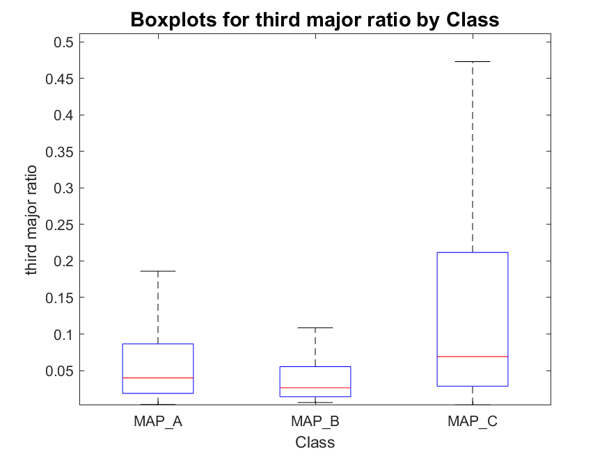
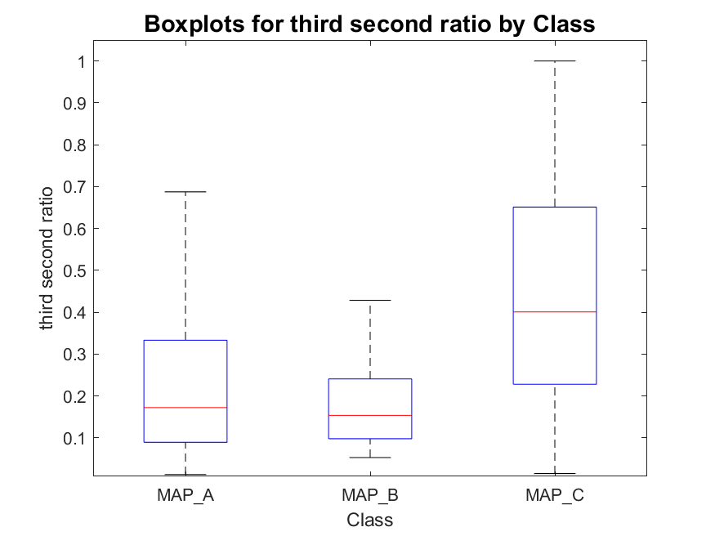
Active phase duration and silent phase duration
MAP_A has:
- 22 signals with one peak
- 254 signals with two peaks
- 387 signals with three peaks
total : 663
MAP_B has:
- 0 signals with one peak
- 41 signals with two peaks
- 53 signals with three peaks
total : 94
MAP_C has:
- 2 signals with one peak
- 12 signals with two peaks
- 76 signals with three peaks
total : 90

Slide 21
Outline
Aim of envelope analysis
Envelope analysis pipeline
Envelope derivative
Derivative thresholding and merging
Time thresholds definition
Results
Proposed features
Improving KB classifier
Conclusions
Appendix: not discriminative features

Slide 22
Knowledge based classifier-v
For each roving trace:
Divide the trace in three regions (Atrial: t<0.38s, His: 0.38<t<0.42 and Ventricular: 0.42<t<0.6);
Compute the absolute value of each region and find the maximum;
Then, apply the following rules:
Notes:
For His phase, consider the maximum and compare it with a threshold,

Slide 23
Knowledge based classifier with new features
For each roving trace:
Improved KB V0: peaks thresholds and position
Improved KB V1: peaks thresholds and atrial/ventricular ratio
Is third peak >0.021?
No
Is peak_1_pos<0.49
No
Is third peak >0.021?
No
Is atrial_ventricular_ratio >0.09?
No
MAP B
MAP B
Yes
Yes
Yes
Yes
MAP C
MAP A
MAP C
MAP A

Slide 24
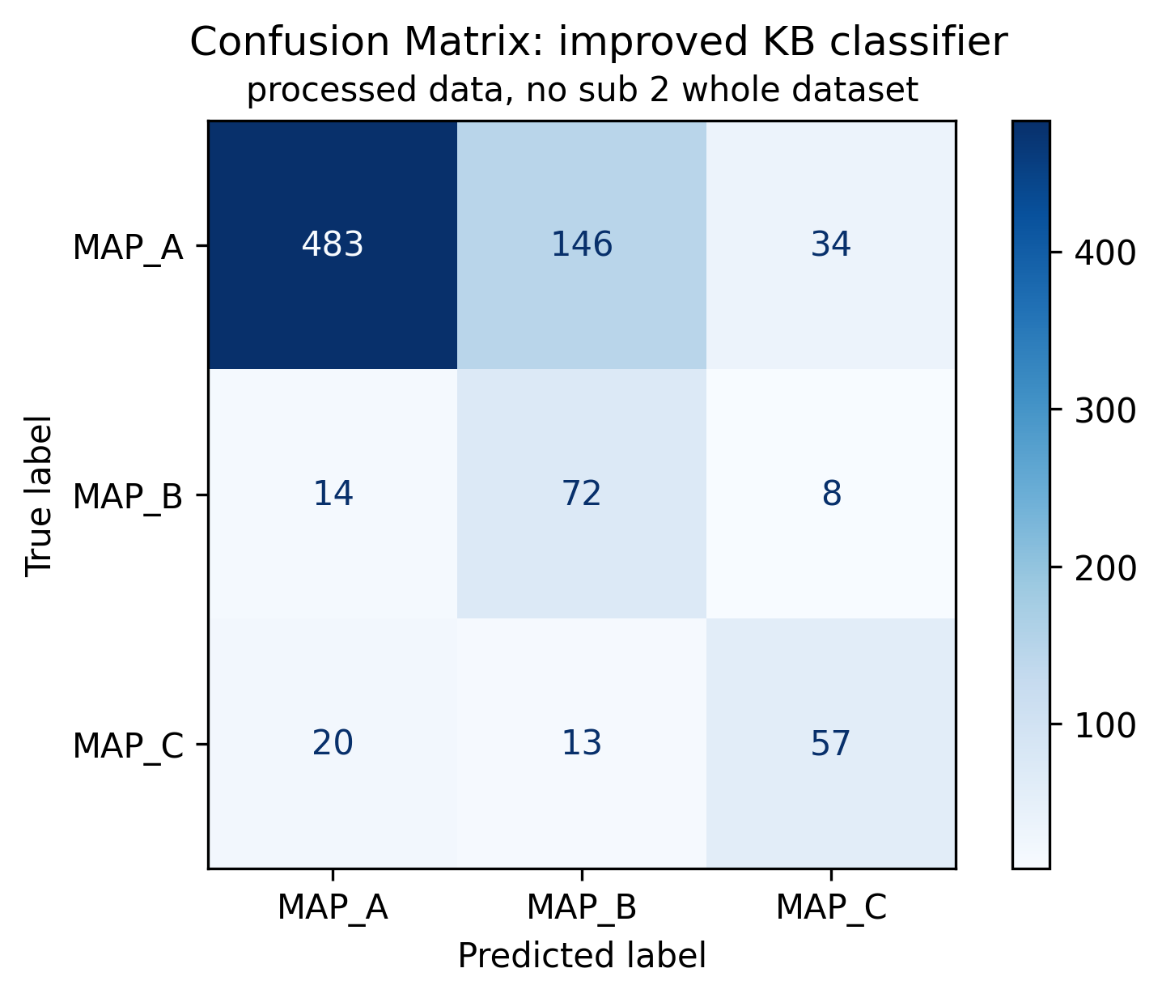
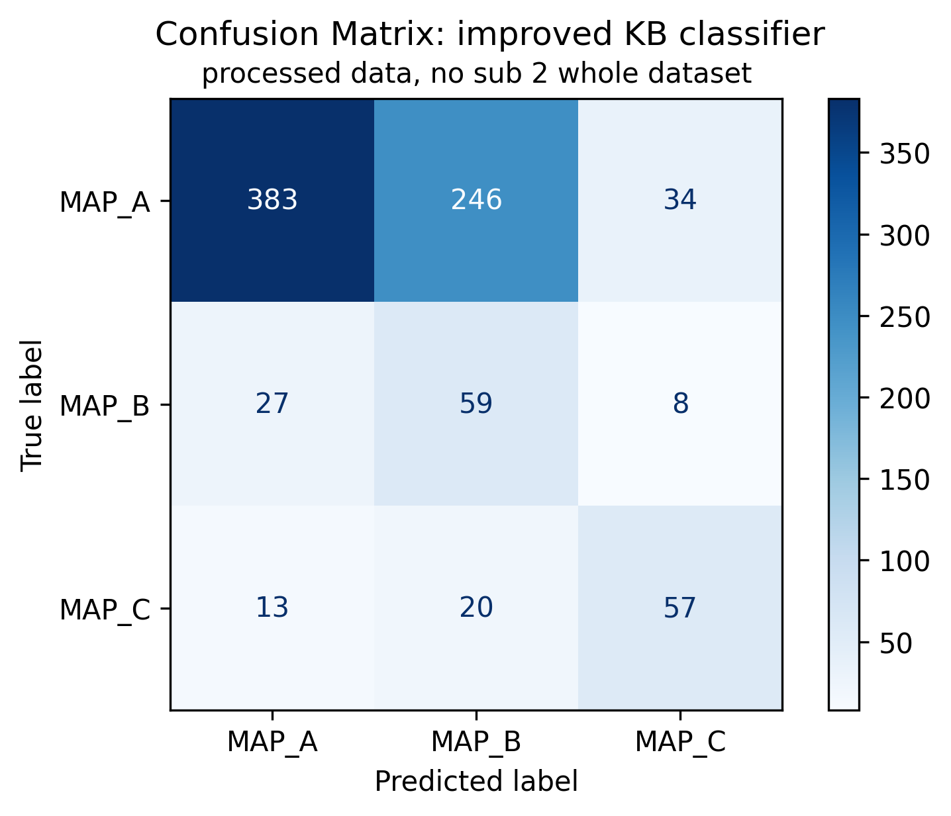
Knowledge based classifier with new features
Improved KB V0: peaks thresholds and position
Improved KB V1: peaks thresholds and atrial/ventricular ratio

Slide 25
Outline
Aim of envelope analysis
Envelope analysis pipeline
Envelope derivative
Derivative thresholding and merging
Time thresholds definition
Results
Proposed features
Improving KB classifier
Conclusions
Appendix: not discriminative features

Slide 26
Conclusions
The proposed pipeline is a first step towards an automated detection of active phases of the signal.
Pros
Automated time-windows definition
High sensibility even to small peaks
Cons
High sensibility to the thresholds used
Merge/removing rules could introduce errors
Peaks cleaning step can be misleading
Sometimes threshold seem to be too low, leading to “false negative” peaks
But in other cases, seems to be too high, leading to “false positive” peaks
In both cases the problem is related to signal amplitude together with threshold definition. More evaluations should be done.
Feature proposed give some initial indications for the classification:
Third highest peak position and value seems to be discriminative of MAP C
Atrial/ventricular peak ratio is confirmed to be a discriminative feature for MAP A and B, but even more seems to be discriminative the first peak position

Slide 27
Outline
Aim of envelope analysis
Envelope analysis pipeline
Envelope derivative
Derivative thresholding and merging
Time thresholds definition
Results
Proposed features
Improving KB classifier
Conclusions
Appendix: not discriminative features

Slide 28
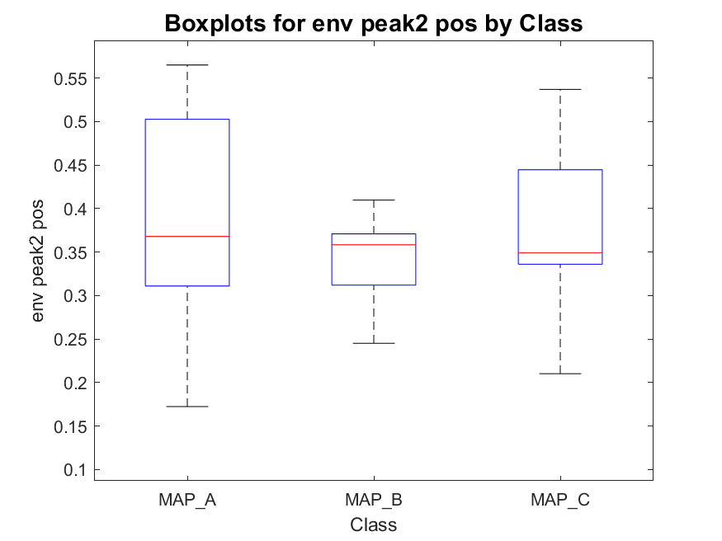
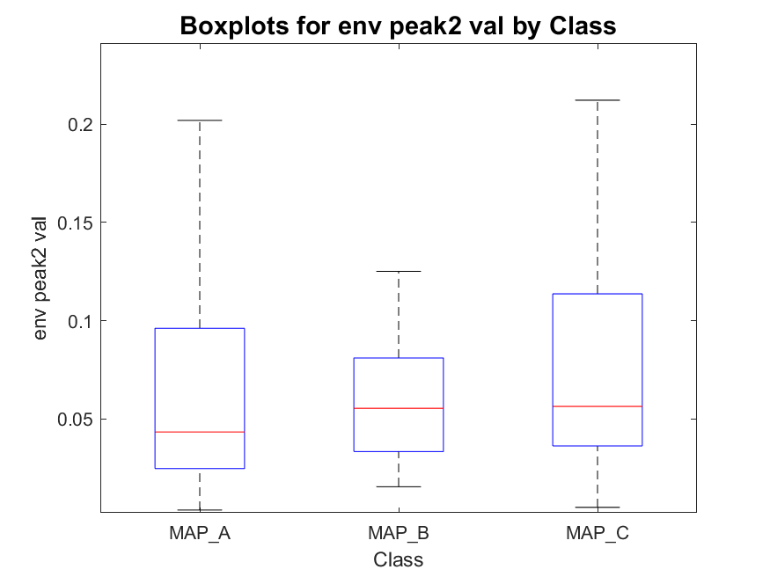
Envelope peak 2 (second highest) position and value
MAP_A has:
- 22 signals with one peak
- 254 signals with two peaks
- 387 signals with three peaks
total : 663
MAP_B has:
- 0 signals with one peak
- 41 signals with two peaks
- 53 signals with three peaks
total : 94
MAP_C has:
- 2 signals with one peak
- 12 signals with two peaks
- 76 signals with three peaks
total : 90

Slide 29
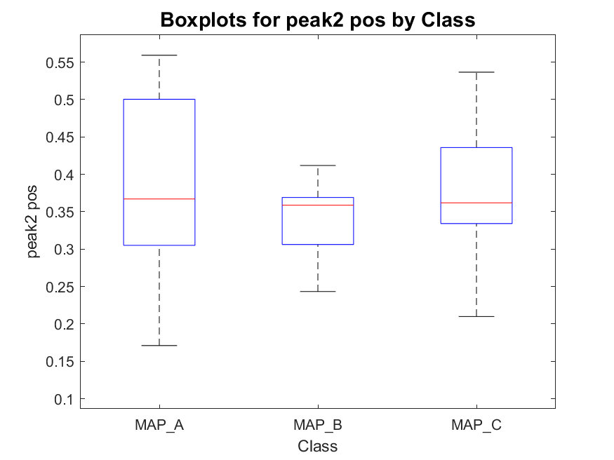
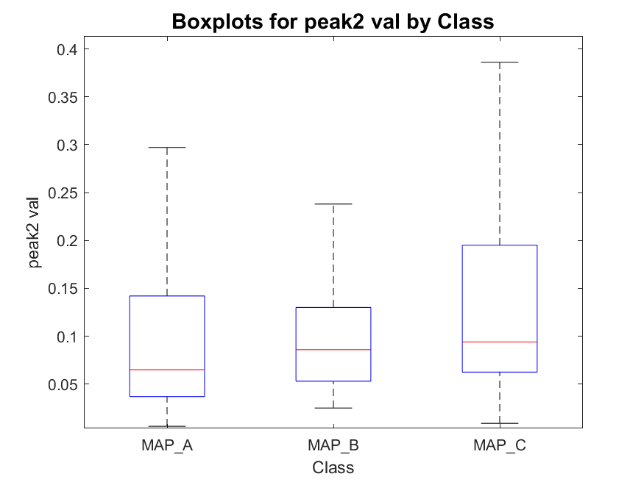
Signal absolute peak 2 (second highest) position and value
MAP_A has:
- 22 signals with one peak
- 254 signals with two peaks
- 387 signals with three peaks
total : 663
MAP_B has:
- 0 signals with one peak
- 41 signals with two peaks
- 53 signals with three peaks
total : 94
MAP_C has:
- 2 signals with one peak
- 12 signals with two peaks
- 76 signals with three peaks
total : 90

Slide 30
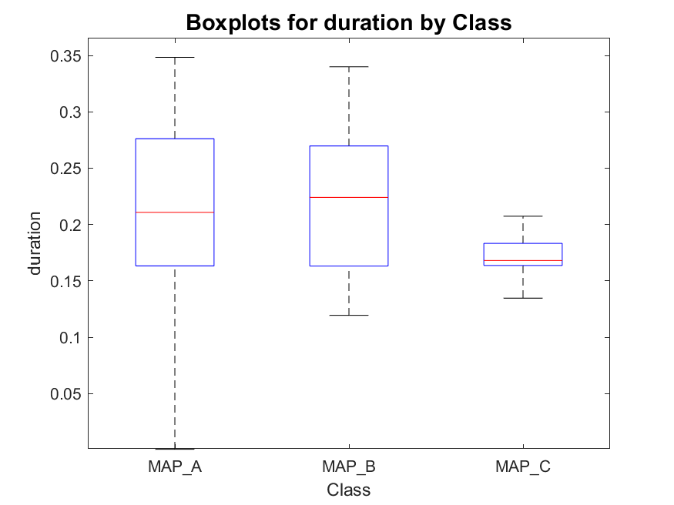
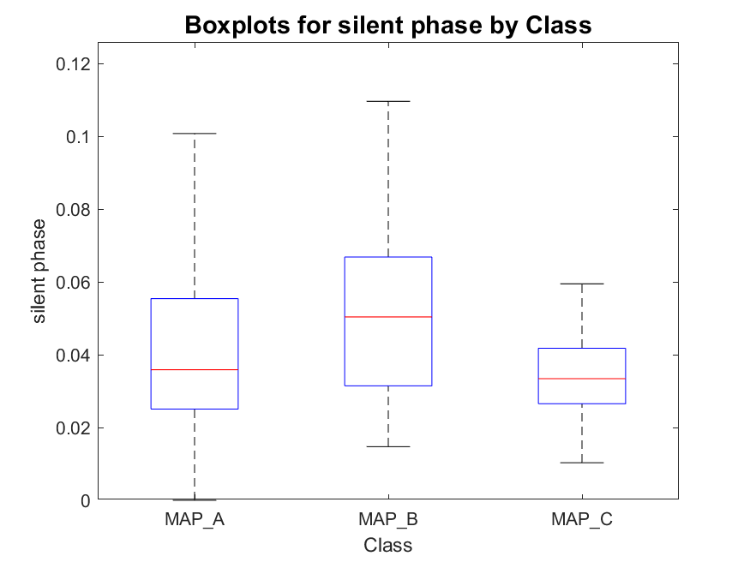
Active phase duration and silent phase duration
MAP_A has:
- 22 signals with one peak
- 254 signals with two peaks
- 387 signals with three peaks
total : 663
MAP_B has:
- 0 signals with one peak
- 41 signals with two peaks
- 53 signals with three peaks
total : 94
MAP_C has:
- 2 signals with one peak
- 12 signals with two peaks
- 76 signals with three peaks
total : 90
Time distance between the first ascent and the last descent.
Areas of inactivity (map=0) within the duration.

Slide 31
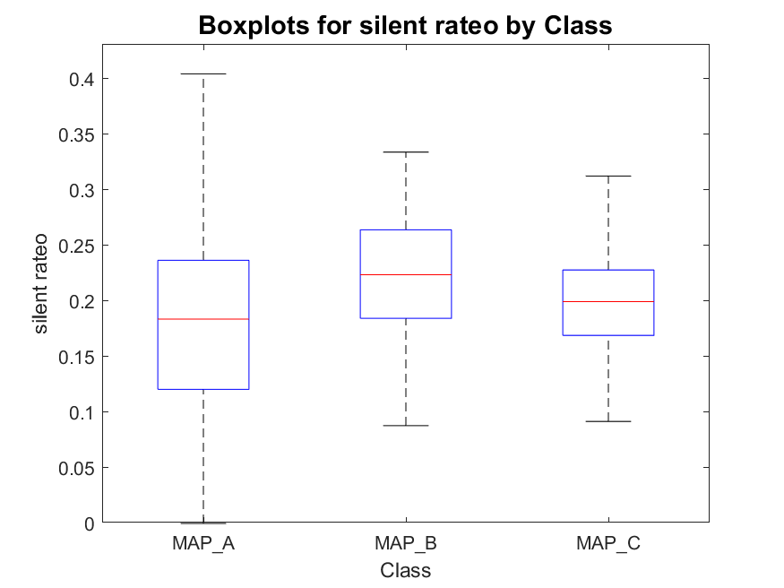
Active phase duration and silent phase duration
MAP_A has:
- 22 signals with one peak
- 254 signals with two peaks
- 387 signals with three peaks
total : 663
MAP_B has:
- 0 signals with one peak
- 41 signals with two peaks
- 53 signals with three peaks
total : 94
MAP_C has:
- 2 signals with one peak
- 12 signals with two peaks
- 76 signals with three peaks
total : 90

